Slide 1
Pronoun-Antecedent Agreement

Slide 2
What do you need to understand about pronoun-antecedent agreement errors?
What’s a pronoun?
What’s an antecedent?
What’s a pronoun-antecedent agreement error?
Notes:
Pronoun-antecedent agreement (or should I say “disagreement”) is a pet peeve of mine. I can’t help myself: when I see it, I want to mark it, and I see it a lot on most freshmen’s papers. My purpose here is to explain the error to you so that you can attempt to identify it and eliminate it from your own writing.

Slide 3
What’s a Pronoun?
A pronoun is a word that takes the place of a noun or other pronoun
  It can take the place of a subject word
    (I, you, he, she, it, we, they)
  It can take the place of an object word
    (me, you him, her it, us, them)
  It can take the place of a possessive word
    (my, mine, your, yours, his, hers, its, our, ours, their, theirs)

Slide 4
What’s an antecedent?
The word that the pronoun replaces.
  Hermione Granger threw her wand onto the floor
    (“her” renames “Hermione Granger”).
  When Ron Weasley saw the wand drop, he picked it up and handed it to her.
    (“it” renames the “wand”)
  Then Ron and Hermione went to their Defense Against the Dark Arts class.
    (“their” renames “Ron and Hermione”)

Slide 5
Basically, it’s this:
All pronouns and their antecedents need to agree in person and number.

Slide 6
Agree in Person
  I hate to proofread my paper because proofreading is such a boring thing for you to do.
    (disagreement in person--first person antecedent “I”, second person pronoun “you”)
  "Why should I study literature? You don't get anything out of it"
    (disagreement in number—I shouldn’t study it because “you” don’t get anything out of it?

Slide 7
Agree in Number
Singular antecedents get singular pronouns
  The boy tossed his hat on the table.
Plural antecedents get plural pronouns
  The boys tossed their hats on the table.

Slide 8
You’ll generally run into problems in two cases:
When the antecedent is an indefinite pronoun and
When the antecedent is a singular noun that could refer to a man or a woman.

Slide 9
Indefinite Pronouns: They’re usually singular
Another | Anybody | Anyone | Anything
Each | Either | Everybody | Everyone
Everything | Little | Much | Neither
Nobody | Nothing | No one | Nothing
One | Other | Somebody | Something
Someone

Slide 10
Except when they’re plural
Both | Few | Many
Others | Several

Slide 11
Or when they’re singular or plural, depending on context
All All of the gas is gone. All of the kids are gone. (“All” refers to “gas” in the first sentence and “kids” in the second) | Any Any of the jewelry is yours for the taking. Any of my cousins are right for the part (“Any” refers to “jewelry” in the first sentence and “cousins” in the second) | More More of the plot is revealed in act three. More of our plans are going towards breaking him out of jail. (“More” refers to “plot” in the first sentence and “plans” in the second).
Most Most of the cake was gone when I got home. But most of the cookies were still there. (“Most” refers to “cake” in the first sentence and “cookies” in the second) | None None of material was covered in the test review. None of the students were happy about that. (“None” refers to “material in the first sentence and “students” in the second) | Some Some of the fault was the teacher’s for being disorganized. Some of the students were so angry they complained to her boss. (“Some” refers to “fault” in the first sentence and “students” in the second)

Slide 12
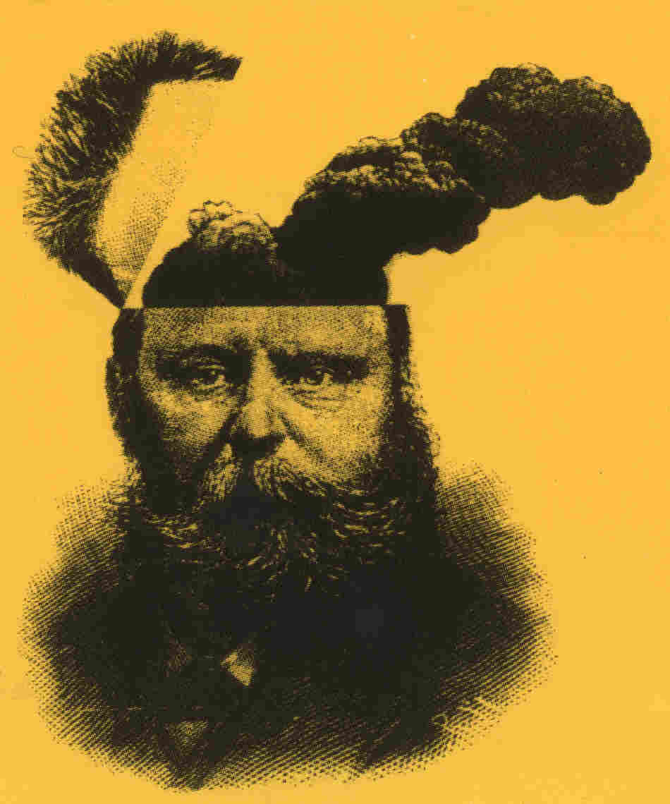
Argh!

Slide 13
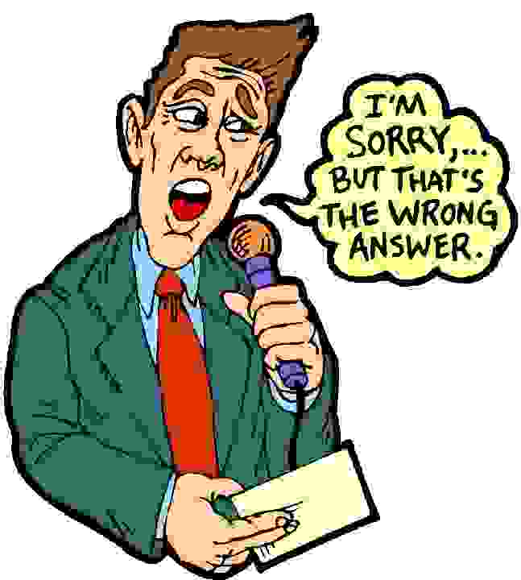
Singular Nouns that Can Refer to a Man or a Woman.
A person should be able to make up their own mind about prayer in schools.
A teacher should show their students love and compassion.
Often, a doctor will leave their patients waiting for a ridiculously long time.

Slide 14

Generally, these errors occur
because the writer is trying to avoid sexism.
When you don’t know if the antecedent is male or female, it seems logical to use the pronoun “they.”

Slide 15
When you can, just make the antecedent plural
A person should be able to make up their own mind about prayer in schools (incorrect).
  People should be able to make up their own mind about prayer in schools (correct).
A teacher should show their students love and compassion (incorrect).
  Teachers should show their students love and compassion (correct).
Often, a doctor will leave their patients waiting for a ridiculously long time (incorrect).
  Often, doctors will leave their patients waiting for a ridiculously long time (correct).

Slide 16
General Pronoun-Antecedent Agreement Rules
Compound antecedents are usually plural;
  Joey and Melissa think their kids are brilliant.
If two antecedents are joined by either/or, neither/nor, the pronoun agrees with the antecedent closest to it;
  Either Michael or his friends will bring their video games to the party.
  Either his friends or Michael will bring his video games to the party. (This sentence is correct, but sounds illogical. Word the sentence like the first example rather than the second).
The pronoun agrees with the antecedent, not the object of the prepositional phrase;
  Each of the dogs needs its own crate.

Slide 17
General Pronoun-Antecedent Agreement Rules
Collective noun can be either singular or plural, depending on the context.
  The jury took only two hours to reach its verdict. (Emphasizes the singularity of the jury)
  The jury took only two hours to reach their verdict. (Emphasizes the jury as a group of individuals)
Avoid sexism
  Not “A doctor should listen carefully to his patients.”
  But rather (1) making the pronoun and its antecedent plural, or (2) reword the sentence.
    Doctors should listen carefully to their patients.
    Doctors should listen carefully to patients.

Slide 18
Vague Pronoun Reference
"Mom wasn't sure if Jane had her make-up,"
  it is unclear if "her" refers to Mom or Jane. Whose make up is it?
“Mom wasn’t sure if Jane had brought Mom’s make up.”
“Mom wasn’t sure if Jane had brought Jane’s make up.”
OR
"Had Jane brought her make up?" Mom wondered.
Mom thought, "Has Jane brought my make up?"

